Slide 1
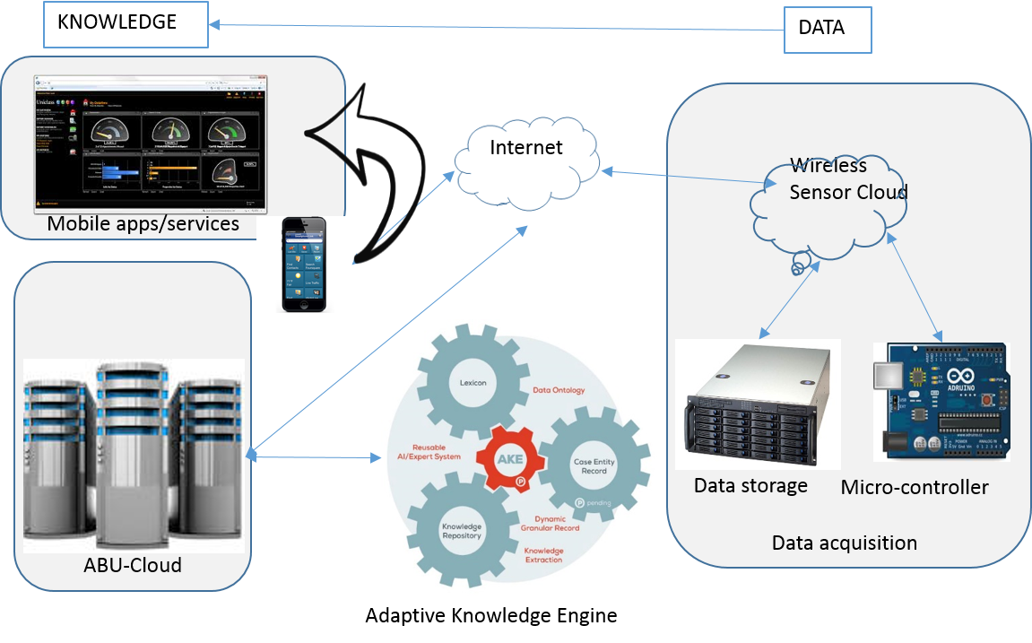
Accurate & Low-cost
Baha Smart Internet of Farming System

Slide 2
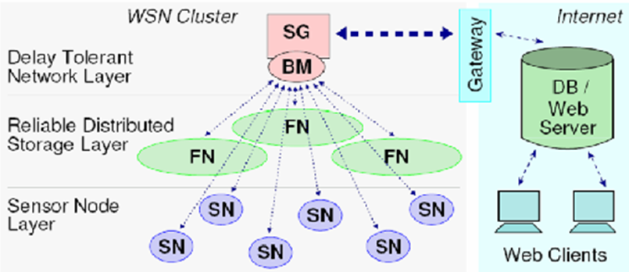
Data acquisition
Patents

Slide 3
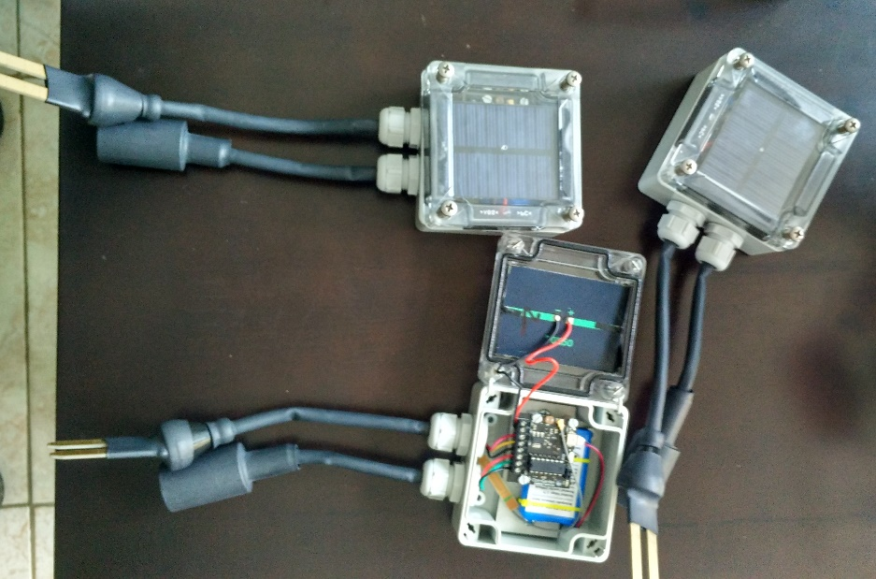
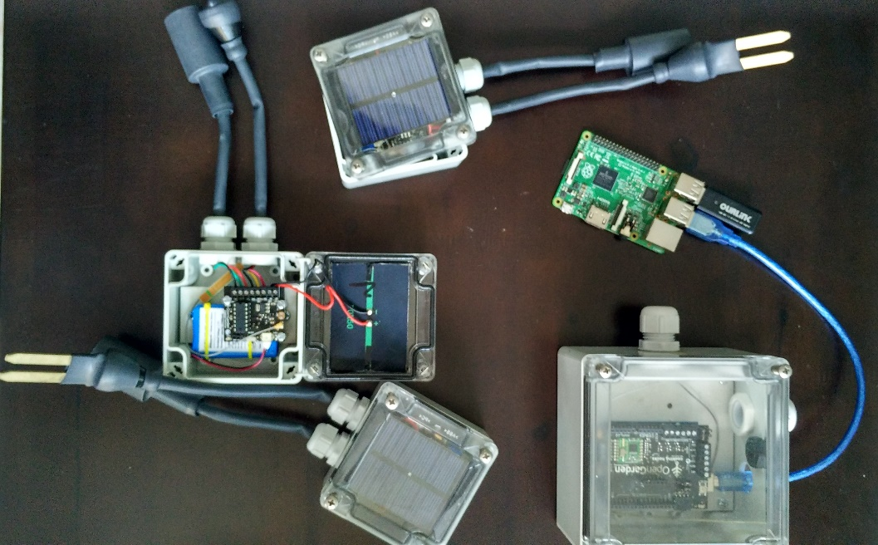
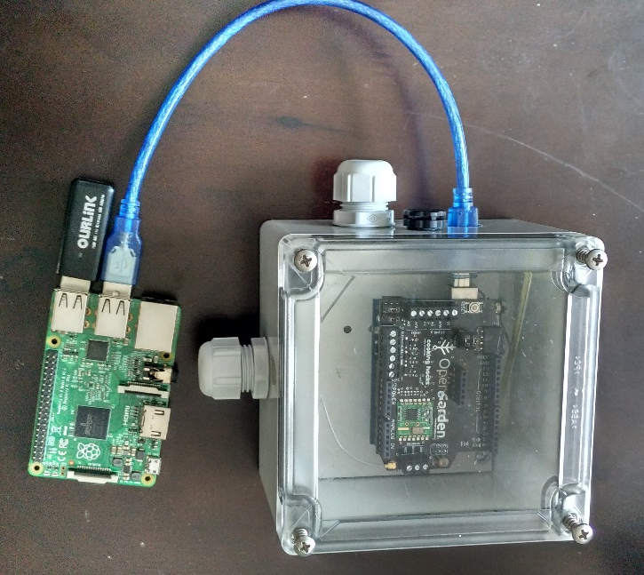
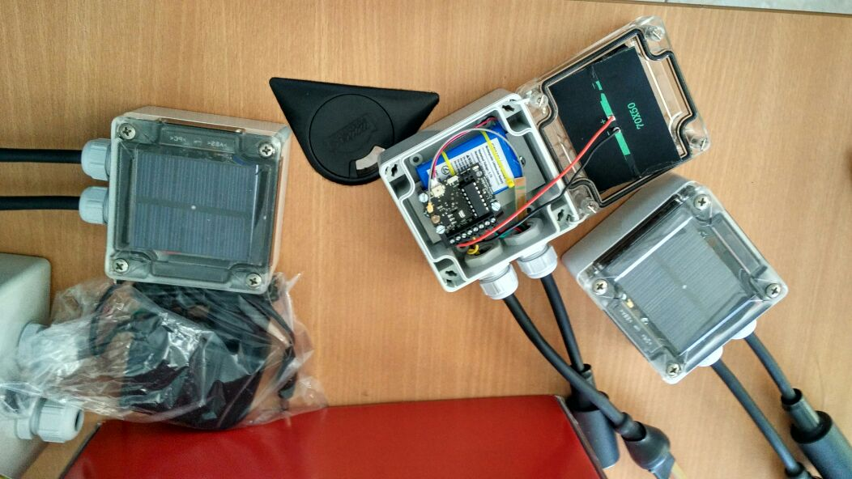
Wireless sensors

Slide 4
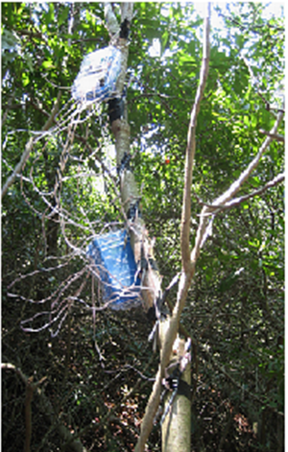
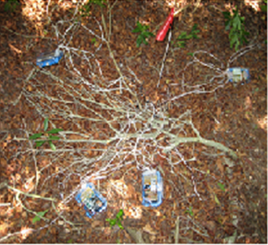
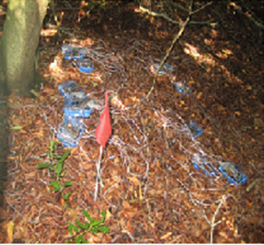
Sensor Nodes in deployment
Patents

Slide 5
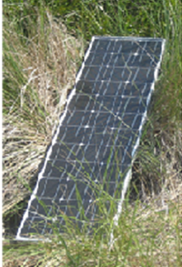
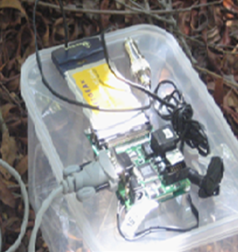
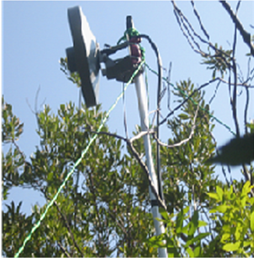
Sensor communication and power

Slide 6
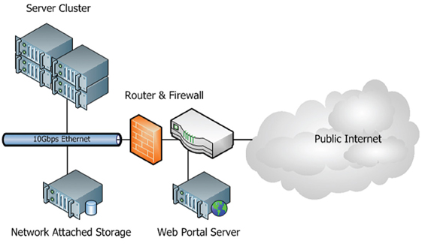
ABU-Cross-Cloud
Infrastucture

Slide 7
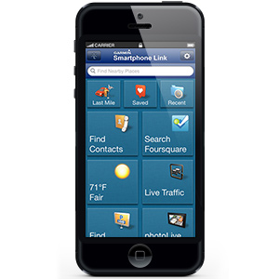

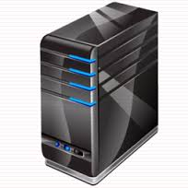
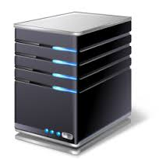
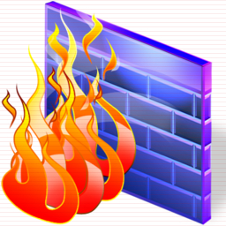

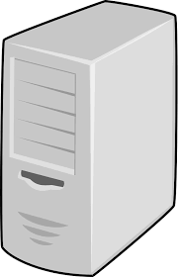
Lab-scale ABU-Cloud
public
private
UEC- Cloud
controller

Slide 8
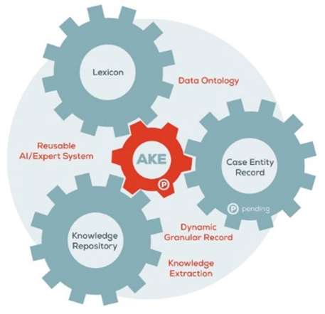
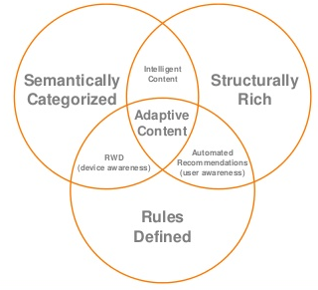
Adaptive Knowledge Engine
Impact factor journal
publications

Slide 9
Mobile applications/services
Real time farm monitoring system
Recommender system
Storage cloud services
Farming management systems
Forum
Weather prediction system
Systems/software/services

Slide 10
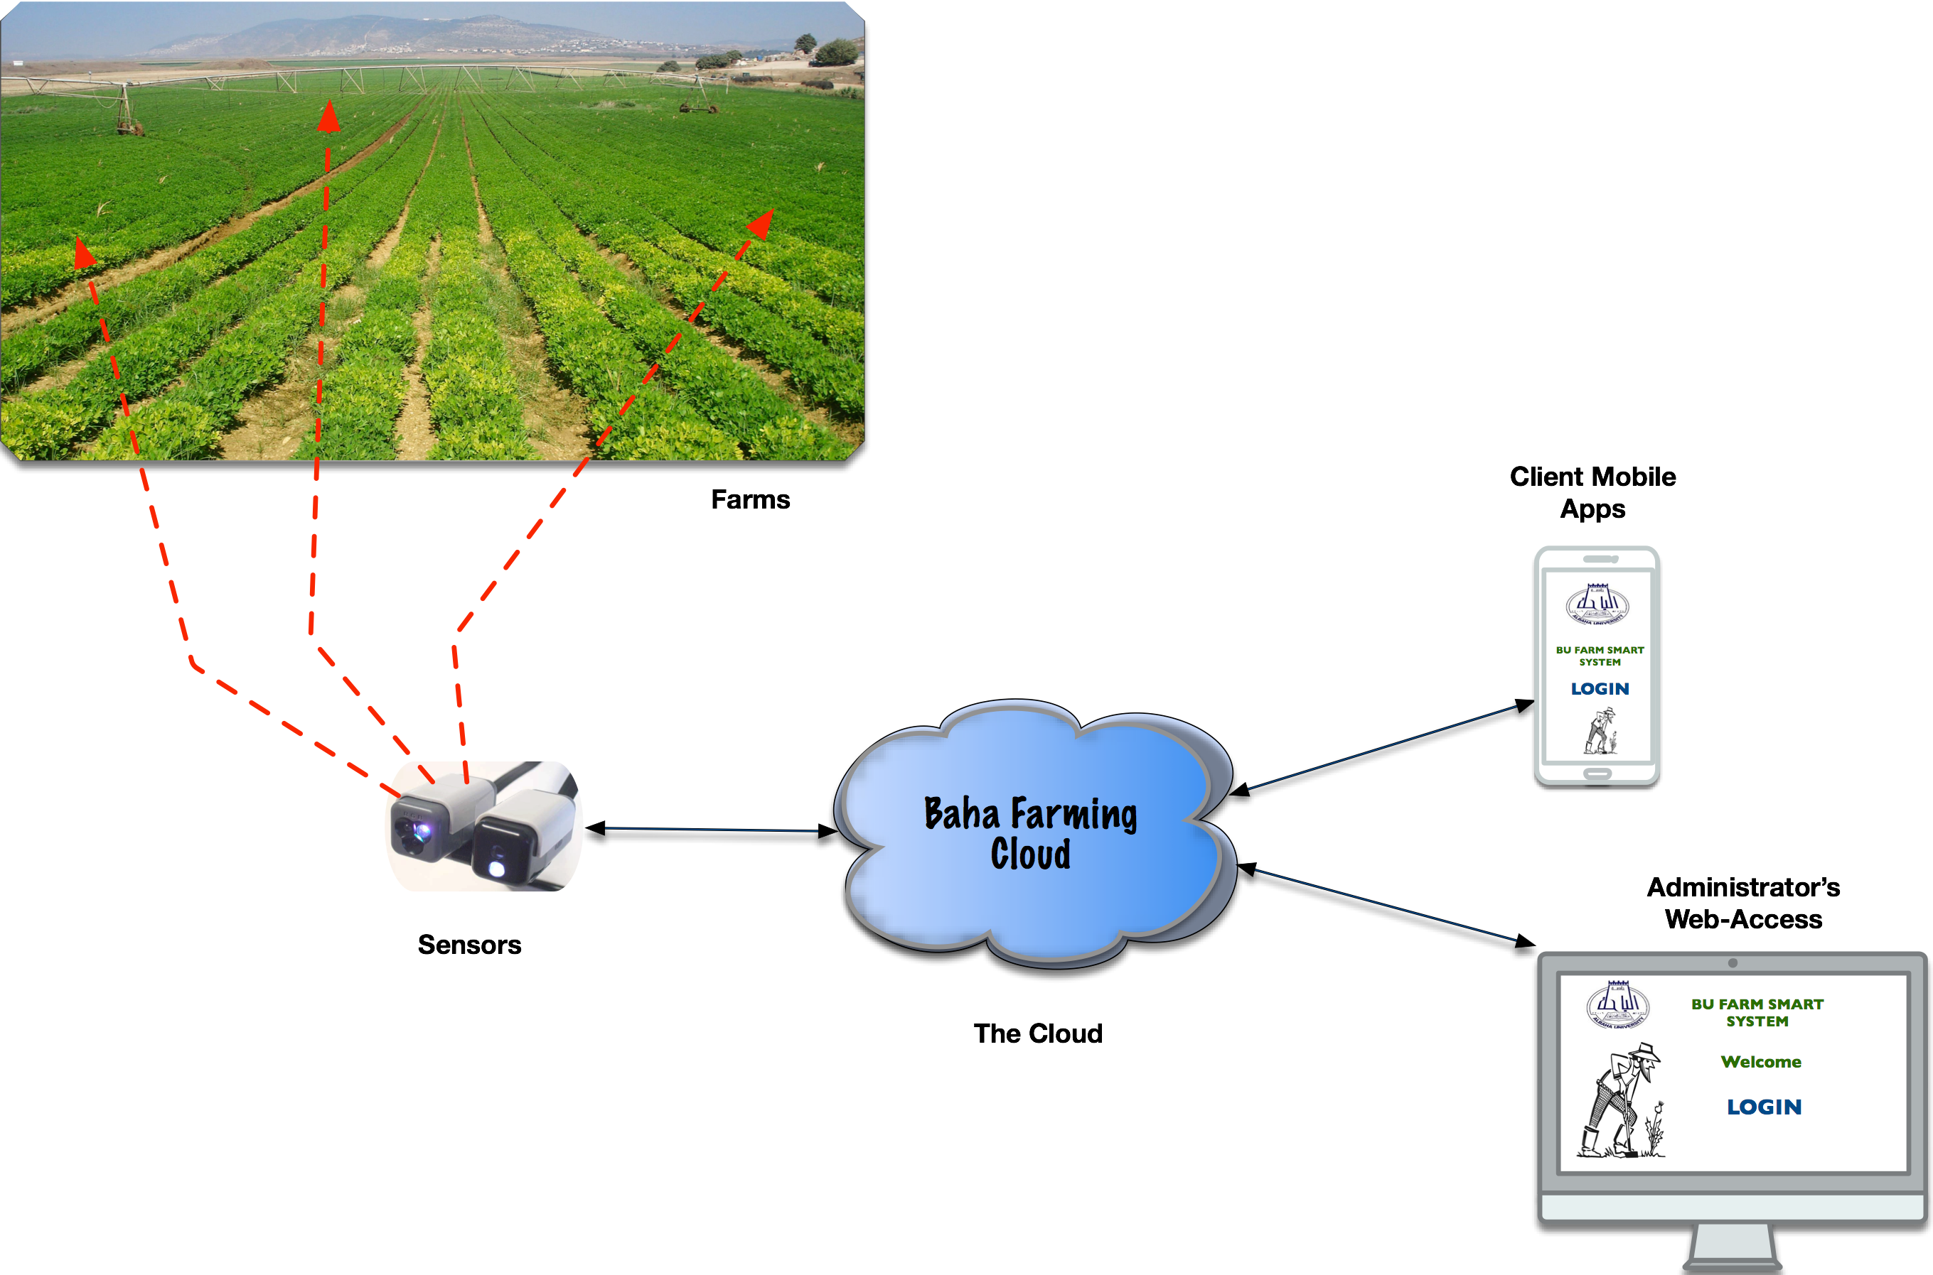
Architecture

Slide 11
Back-end system architecture

Slide 12

Use case diagram for Mobile Baha-FIST
BU Farm System
Manage member ship
Maintain system
Manage sensors
System
Adiminstrator
Monitor farm
Portal’s systems:
Forum
Real time monitoring system
Farming information System
Prediction system
Recommender system
Farmers
Access forum
Access portal

Slide 13
Project Phasing
Phase 1: data → information
Phase 2: data → knowledge
Phase 3: operational and maintenance
Phase 4: commercialization

Slide 14
Budget (Phase 1)
No. | Item & description | Unit Cost (SAR) | Cost (SAR)
1 | P.I (6 months) | 6000 | 36,000
2 | Co-PI (6 months) | 5000 | 30,000
3 | Researchers, Assistant Researcher |  | 36,000
4 | Cloud Equipments (2 high-end servers, 1 standard server, network equipments) |  | 42,000
5 | Sensors & Microcontroller (12 units) | 3000 | 36,000
6 | Travel & conferences |  | 20,000
 | Total cost |  | 200,000

Slide 15
Timeline (Phase 1)

Slide 16
Expected results (Overall)
Output
Systems
  Baha IoF
  Baha Farming Information Management
ISI Impact factor journal publications (2-5)
Patents (2-5)
Outcomes
Capacity building on IoT/IoF
Towards the Saudi Knowledge-based farmer community
Improved skill & innovative farmers

Slide 17
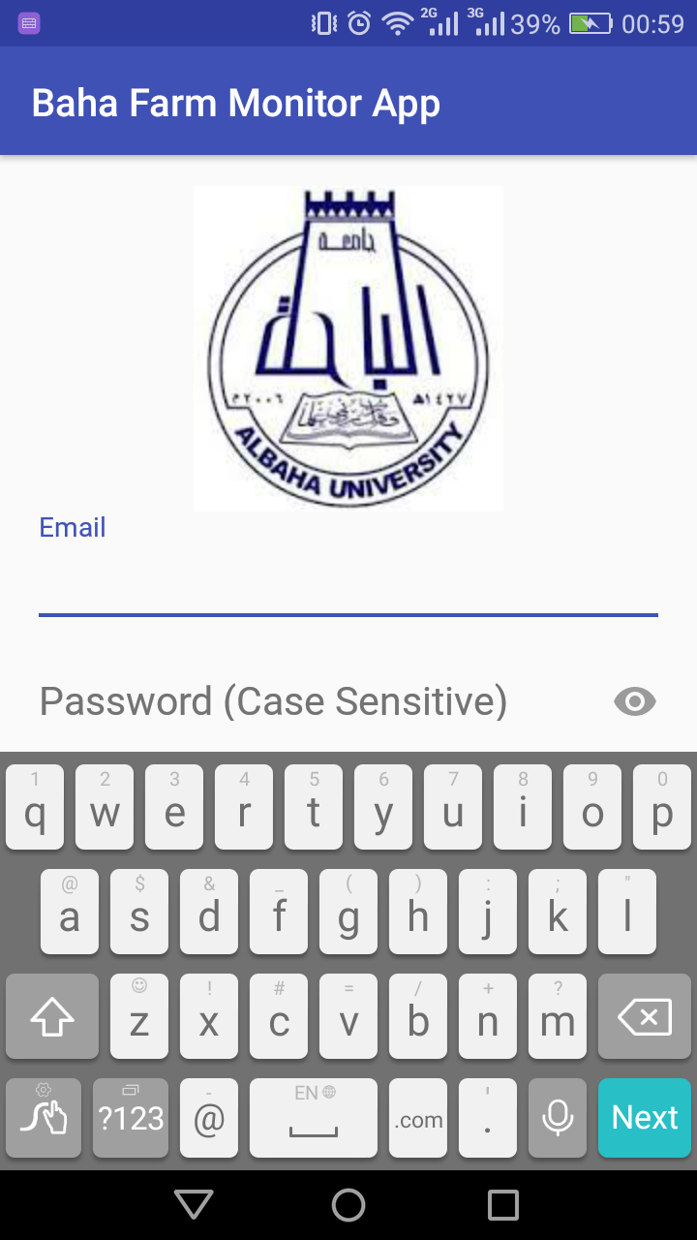
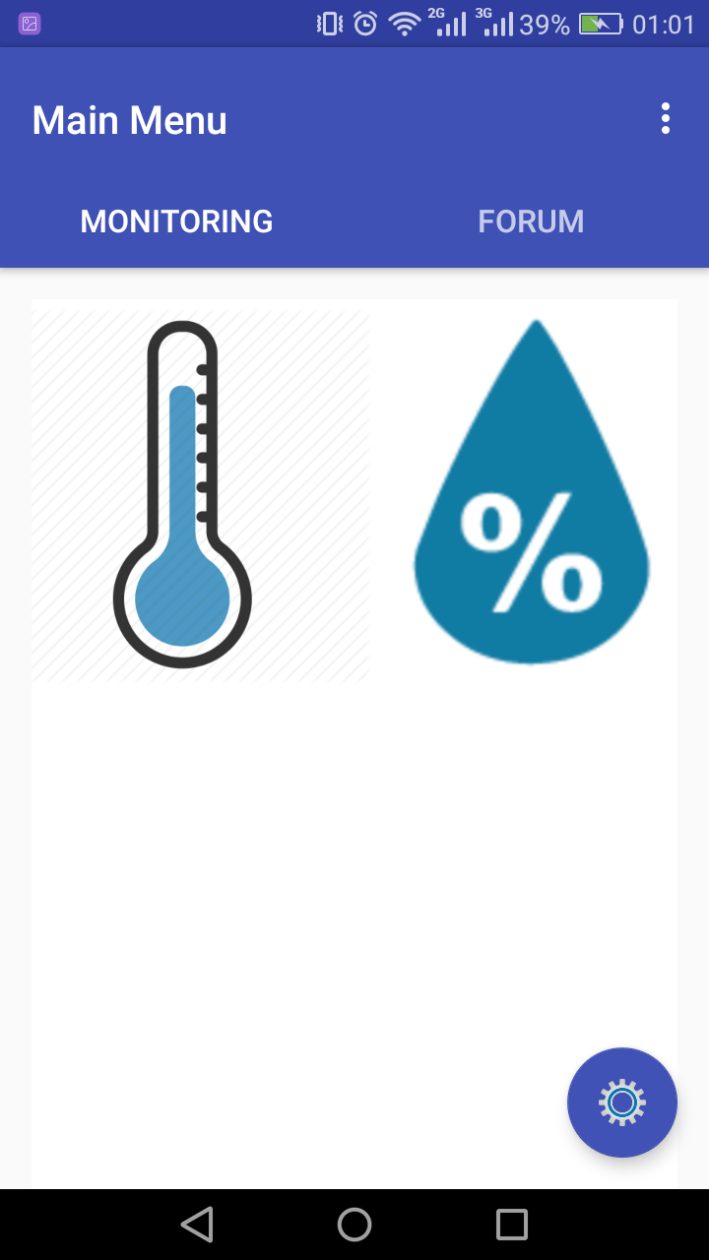
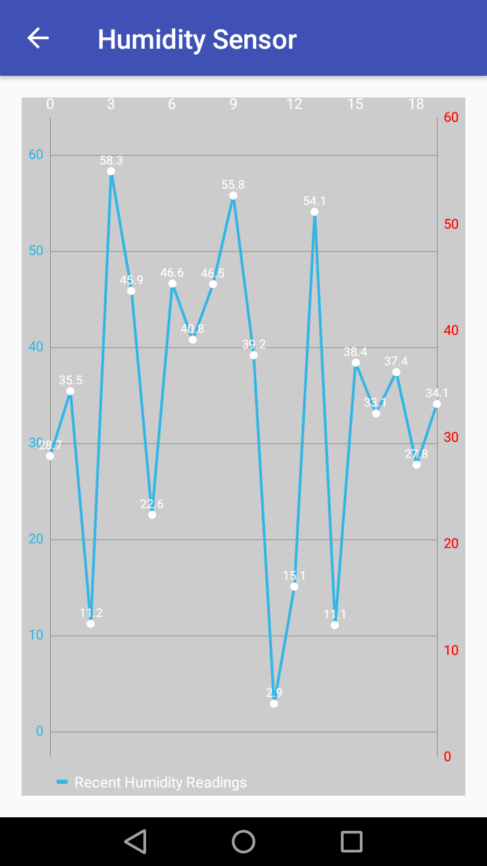

Slide 18
R&D potential
  Teknologi sensor
    Low-cost sensor
    Local need sensor
    WSN Gateway
  Teknologi jaringan
    ABC WSN protocol
    Energy efficient routing protocol
    SDN
  Teknologi perangkat lunak
    Agriculture Expert system
      Remote bug detection for palm tree.
    Big data in agriculture/farming
      Deep learning for feature selection (Tami)
      Evolving MLP for prediction (Romi)
  Smart-Ranah… ☺

Slide 19
References
http://www.utsystem.edu/offices/board-regents/uts165-standards
https://securityintelligence.com/the-importance-of-ipv6-and-the-internet-of-things/
http://www.isaca.org/Knowledge-Center/Research/ResearchDeliverables/Pages/internet-of-things-risk-and-value-considerations.aspx
https://www.owasp.org/images/7/71/Internet_of_Things_Top_Ten_2014-OWASP.pdf
https://www.owasp.org/images/3/36/IoTTestingMethodology.pdf
http://blog.sec-consult.com/2015/11/house-of-keys-industry-wide-https.html
http://blog.trendmicro.com/trendlabs-security-intelligence/high-profile-mobile-apps-at-risk-due-to-three-year-old-vulnerability/#
http://www.rs-online.com/designspark/electronics/knowledge-item/eleven-internet-of-things-iot-protocols-you-need-to-know-about
https://thenewstack.io/tutorial-prototyping-a-sensor-node-and-iot-gateway-with-arduino-and-raspberry-pi-part-1
http://www.business.att.com/content/article/IoT-worldwide_regional_2014-2020-forecast.pdf
http://blog.talosintel.com/2016/02/trane-iot.html
http://krebsonsecurity.com/2016/02/iot-reality-smart-devices-dumb-defaults/
http://www.gsma.com/connectedliving/gsma-iot-security-guidelines-complete-document-set/

Slide 20
شكرا

